Slide 1

LendingClub Case Study
Group Members:
Gogineni Sreeram Prudhvi & Anusha Saxena
5th October 2022

Slide 2

Introduction
LendingClub is financial services company and a digital marketplace that offers the largest peer to peer lending platform for personal loans, business loans, auto refinancing and financial services for patients.
Background
LendingClub has to make decision for loan approval based on the information of past loan applicants, that indicates if a person is likely to default or not. Which would be used to determine the grant or denial of loan or lending at higher interest rates as per the risk associated.
Objective
Perform EDA to analyze the dataset from the past applicant's information. Identify the variables that indicate defaulters in best ways and could be used provide insights for making decisions on approval or rejection or interest rates or amount of loan to be granted.

Slide 3
Analysis Steps
Data Understanding
Data Cleaning
Data Analysis
Conclusion with Results
Studying and validating the data
Identifying the target variable
Identify the important columns in dataset that may contribute in analysis
Cleaning Missing values
Removing Redundant columns
Removing rows with all zero
Convert the values to proper datatype such as float, int etc.
Univariate Analysis
Segmented Univariate Analysis
Insights and Observation

Slide 4
Data Understanding
Types of variables
• Customer information
• Loan related information
• Customer behaviour (If the loan is granted)

Slide 5
Data Understanding - Overall Default Rate is 14%

Slide 6
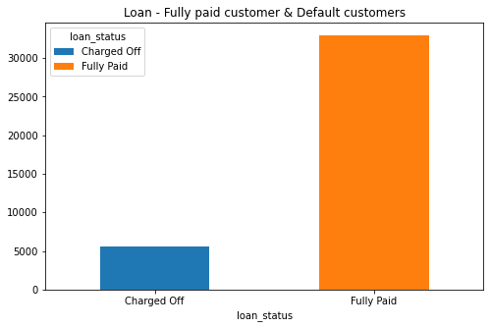
Data Analysis - Loan fully paid & Default customers
In this dataset we have
32950 – Fully paid customers,
5627 – Default customers
As per our analysis 84% of fully paid customers and 13% of default customers in this dataset

Slide 7
Data Analysis - Loan status by term

Slide 8
Data Analysis - Analysis based on Loan periods
The impact of tenure (36 months and 60 months) of fully paid and default customers. The mostly default customers close to 58% of customers opted for 36 months of loan period. Comparatively 79% of fully paid customers opted for the 36 months of loan terms.

Slide 9
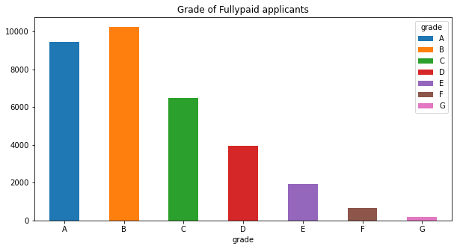
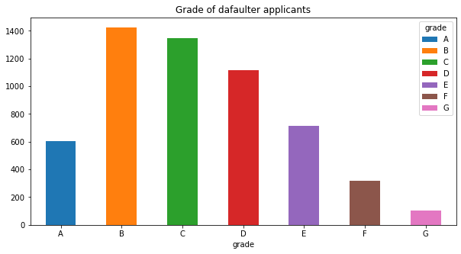
Data Analysis – Grade based analysis
In this grade based analysis most of the defaulters comes under the B & C grade. 49% defaulter are belongs to these two grade. Grade G has low defaulters (1.8%) compared with other grade defaulters.

Slide 10
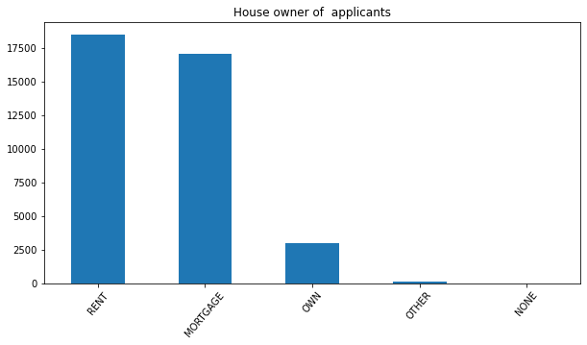
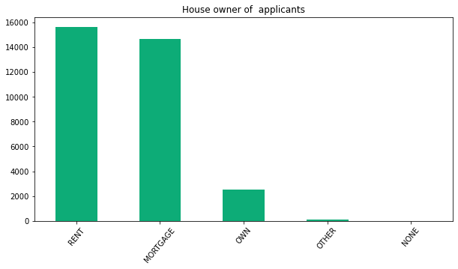
Data Analysis – Household by customers
The most of the customers are staying in rented house and mortgage. The most default customers close to 3000 customers (51%) out of 5627 customers are staying in rented house. Who has own house, they’re very less like to be a defaulters (7%) customers.

Slide 11
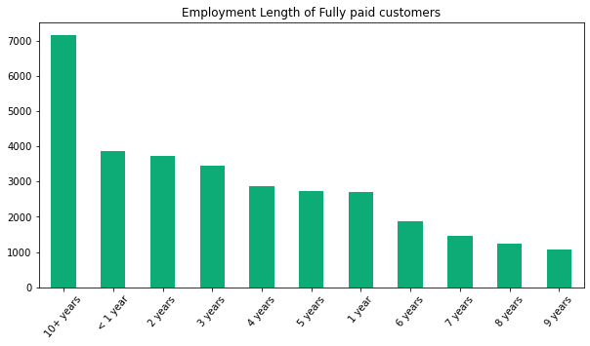
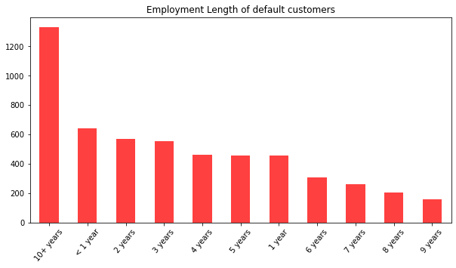
Data Analysis – Employment length of customers
The employment duration is not having much difference of both type of customers. Both type of customers has equal ratio of employment duration. But whohas1yearandlessthan employment duration more likely to be a defaulters compared with others.

Slide 12
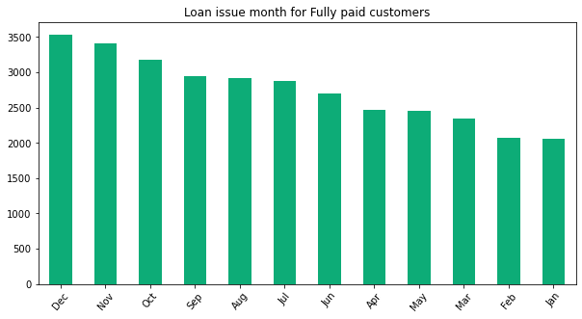
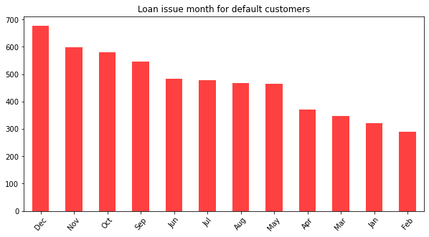
Data Analysis – Loan provide to the customers on particular period
The slight variance in customer who has taken the loan on the particular months. Comparatively customers who has taken loan in the month of June more likely to be defaulter apart form other months. This might be due to season health issue or having festivals etc..
Especially in the month of Dec have festivals like Christmas and New year shopping. Due to this reason customer couldn’t pay the EMI for the month. This leads to be defaulter.

Slide 13
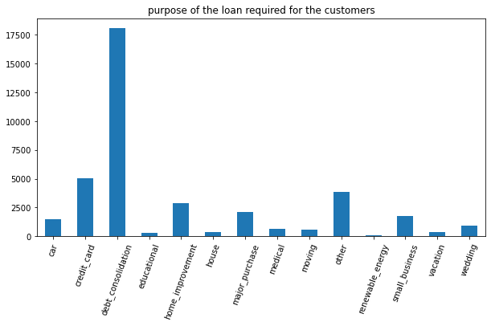
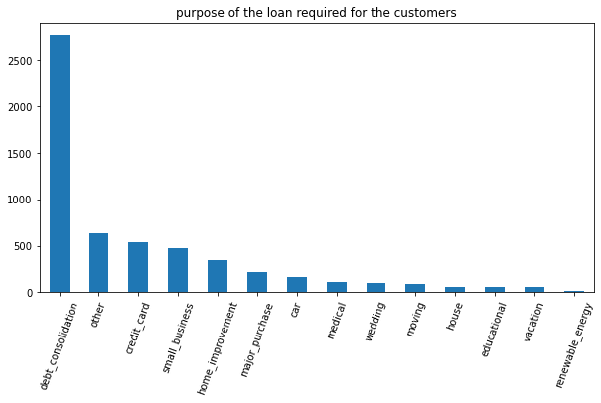
Data Analysis – Purpose of the loan
The loan provided to the customers in various category. The customer who has taken loan against debt consolidation more likely to be a defaulters. 49% of default customer who has taken the loan on debt. the customers who taken loan for renewable source has less defaulters (0.34 %).

Slide 14
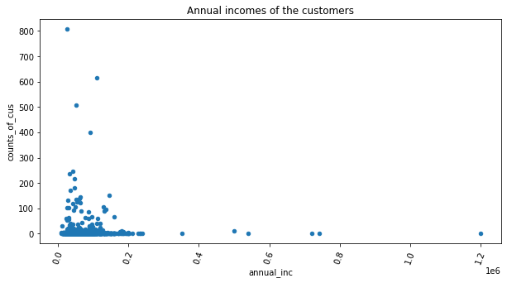
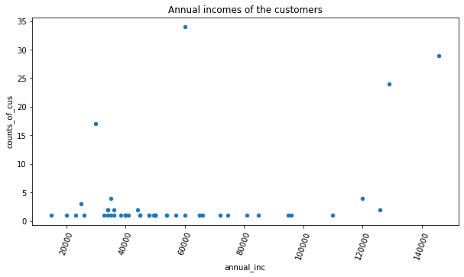
Data Analysis – Customer annual income base analysis
The customer who has < 20k of annual more like to applied for the loan and almost paid their loan amount. The customer who has close to 40K of annual income has applied loan less but for their category they would’ve opted more loan amount, but most of them couldn’t pay on or before the time. So they’re very much likely to defaulters compared with other customers.

Slide 15
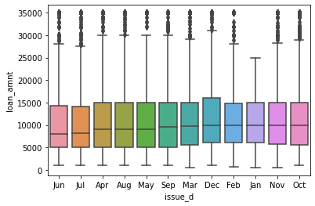
Data Analysis – Minimum Loan amount provide particular period
The loan investors provide the average loan amount to customers for the particular period. Based on data we’ve month of Dec played major role in it and month of Jan likely to be less.
Almost all the month averagely investors given loan close to 10K.

Slide 16
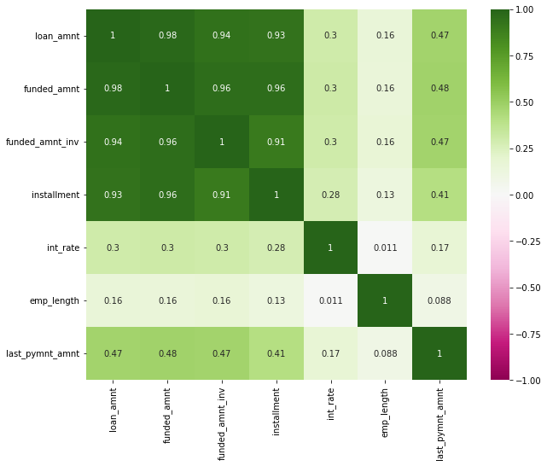
Correlation Analysis
The correlated data - 98% of correlation between loan amount and funded amount.
It’s like the customer request amount and the investor paid amount are correlated.
The loan amount, funded amount and funded amount by investors are mostly correlated. When loan amount increases the funded amount also likely to be increased.

Slide 17
Conclusion
As per this analysis Grade, Term, Bin, interest rate, Year, and Home Ownership are the important variables. The defaulter are more like to be in rented house and takes the more duration of loan period and high amount of loan.
As per our suggestion the investor shouldn’t give the requested full amount to the customers even though whoever eligible for higher amount.
The investor should consider the factor household by customer and total income for the customer. Based on these factors, they can provide lesser amount than the requested amount whoever staying apart from own house and whoever taking the higher loan amount. Consider these factor to avoid the risk of business.

